Slide 1
VIRTUAL MEMORY MANAGEMENT
Thrashing - working set model

Slide 2
Thrashing
Thrashing is when a process is busy swapping pages in and out.
-Page Fault : Occurs when a program attempts to access a block of memory that is not stored in the physical memory.
-Swapping : Process can be temporarily swapped from main memory to secondary memory so that the main memory can be made available for other processes.

Slide 3
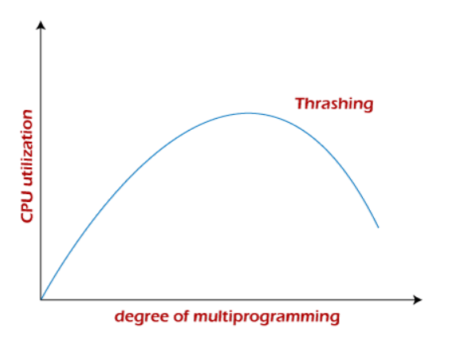
Causes of Thrashing :
If CPU utilization is too low then we increase the degree of multiprogramming by introducing a new process to the system. The CPU scheduler sees the decreasing CPU utilization and increases the degree of multiprogramming.

Slide 4
Algorithms during Thrashing :
Global Page Replacement :
-The replacement frame selected by a process can be any frame from the set of all frames.
-Page stealing.
- Advantage is greater system throughput, Disadvantage is that it cannot control it’s own page faults.

Slide 5
Continued…………
Local Page Replacement :
- The replacement frame selected by a process can only be from the set of frames which are allocated to it.
-A process cannot select the frame which is currently allocated to other process.
The Local Page replacement is better than the Global Page replacement

Slide 6
Techniques to prevent Thrashing :
Working Set Model :
-It starts by looking at how many frames a process is actually using. This defines the locality model.
-Δ ≡ working-set window ≡ a fixed number of page references Example: 10
-WSS_{i} (working set of Process P_{i}) = total number of pages referenced in the most recent Δ (varies in time)
if Δ too small will not encompass entire locality
if Δ too large will encompass several localities
if Δ = ∞ ⇒ will encompass entire program
-Total demand frames D = Σ WSS_{i} and Total Available frames is m
Then if D > m ⇒ Thrashing
if D <= m, thrashing doesn’t occur

Slide 7
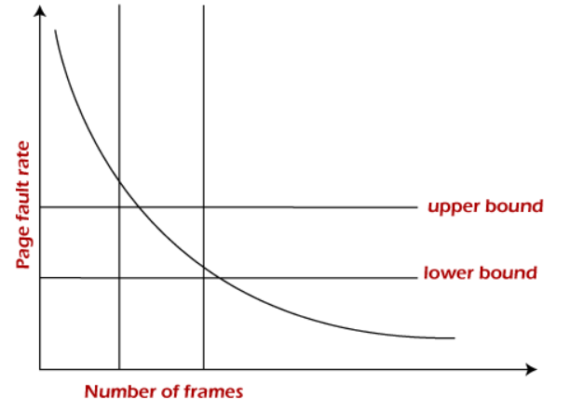
Continued………….
Page Fault Frequency :
-If the page fault rate is too high, it indicates that the process has too few frames allocated to it.
-A low page fault rate indicates that the process has too many frames.
-If the page fault rate is high with no free frames,
some of the processes can be suspended and allocated
to them can be reallocated to other processes.
The suspended processes can restart later.

